Slide 1

AGILE PRESENTATION
Jose Martinez
Southern New Hampshire University
CS-250-T3645
Instructor: Tammy Morrison

Slide 2
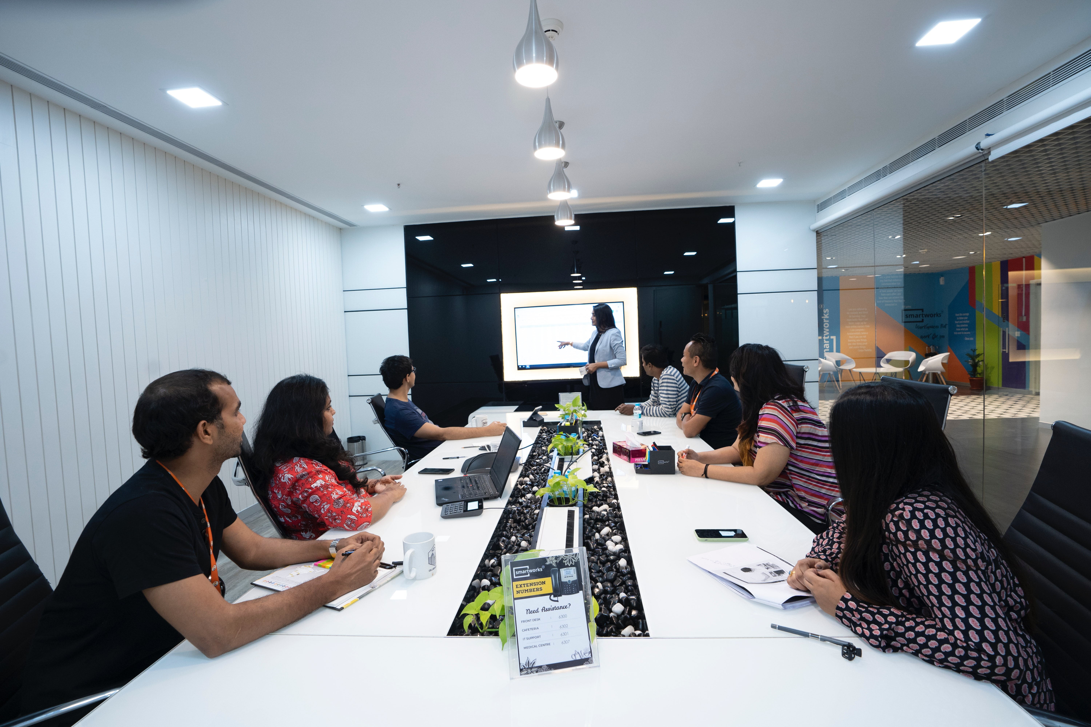
Roles in an Agile Scrum Team
Product Owner
Scrum Master
Developer Team
Tester Team

Slide 3

Product Owner
The Product Owner is the main point of contact with the Client and is an acting representative for the client within the project. The Product Owner defines the vision for the project.
They create the user stories for the scrum team, set the priority levels for each user story and decide on stories that they might think could belong on the backlog.
Oversees development stages in the agile process.
Evaluates the projects progress.
If the client has change of direction in terms of what they need the product owner is there to adapt to those changes and rely the information to the scrum team.
(Lucid Content Team, n.d.)

Slide 4

Scrum Master
The Scrum Master is active in terms of knowing what is going within the teams.
Helping the team meet scrum sprint deadlines.
Only actively involves themselves in the team scrum meetings if there are internal issues or any issues with the sprint themselves that need his special knowledge in the matter.
Keeping the team upbeat, positive and moving forward within given project.
Works with the product owner to effectively produce a consistent backlog where the team can be the most productive.
Leading, training and coaching an organization in the adoption of scrum.
(What is a Scrum Master, 2022)

Slide 5

Tester
The Tester makes sure that the user story functionality is tested and able to function within said project.
They tester team might follow TDD (Test Driven Development) or TFA (Test First Approach) meaning that while the developer team can focus on the UI (User Interface) of the project, the testers can write passable test, for said functionality or component that will decide if such add on to the project is passible or must either be eliminated or put on the backlog to better refactor it into the project.
The tester team may implement various version of the product or functionality (beta 1, 2…etc, alpha) before rolling out that feature or add on.
Tester work together with the developers to figure out the best approach to move forward after writing the test that either passed or failed.
Testing the functionality first is key for the project since the testing of such addons prevent further issues once the project or feature is pushed into production.
(Jayaraman, 2020)

Slide 6

Developer
The developer is tasked with the designing of the front end and backend of the project.
They work off the user stories provided by the Product Owner and interact with both the Scrum Master and testers to better plan out scrum sprints and make sure the proper functionality is implemented in the project.
Working closely with the tester team to put out product with the least number of bugs. Which saves on time of refactoring parts of the project, which is costly. Shipping a lean product into production.
Being able to adapt to the agile development process and make changes on the go, without much effort or issues.
Controlling the increments within each scrum with the Scrum Master. Specifying what parts are the most important to complete first in the backlog.
(Adam, 2020)

Slide 7
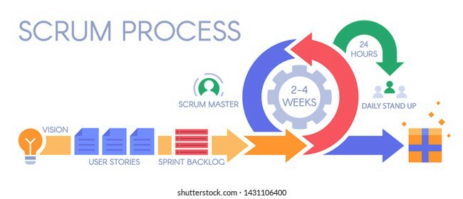
Describing how the Scrum Agile approach helped the SLDC
The travel agency needed an overhaul to adapt to the new market of travel destination. By using the SLDC (Software Development Life Cycle) we were able to deliver new functionality to the travel platform in a timely and low costing approach.
By simultaneously improving quality and shortening the the production time, we were able to add a custom profile option to the SNHU Travel Agency. By defining the requirements for the new implementations, we were able to better test what would pass or fail prior to pushing it to the development team, for than to have the new feature go into production.
Maintaining code quality at every stage of development was important by refactoring the Java code given and implementing the new functionality within the Java code, by adding new images and refactoring the code to become more modular.
The different stages of requirement analysis, planning, architecture design, developing the software, testing and finally deployment was a key guide. It provided the scrum team quality scrum meetings and a proper way to adapt how long or how short each task needed to be for each sprint.
By communicating with the Product Owner, identifying the problem and planning out proper user stories to better adjust the backlog, we managed to add a favorites list, custom profile, different payment options and a way to cache most bought vacations.

Slide 8
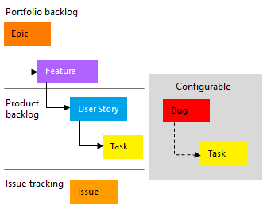
Adjustments made When the project theme was rearranged
By continuously having an issue tracker in place and agile being so flexible, we were able to adjust our backlog, revise or remove some user stories to better fit the change and retest this new implementation of the travel platform.
Since the API fetching was going to be more geared towards detox and wellness, we refactored the Java code after testing, adjusted the images and descriptions of the destinations being rendered and added a filter to the fetching of the API call. By changing the attributes of the object being called in our fetch function.
Once the we were able to fetch the proper data, tested our new end point and refactored the UI, everything was working in conjunction with the prior state of the travel agency platform.
Though we did have bugs, they were not in anyway affecting the teams from switching the theme of the travel platform at all. Since our work was mainly at the stage of the backlog where we needed to cache user data to provide each user with a custom home page when they returned for a new session.

Slide 9
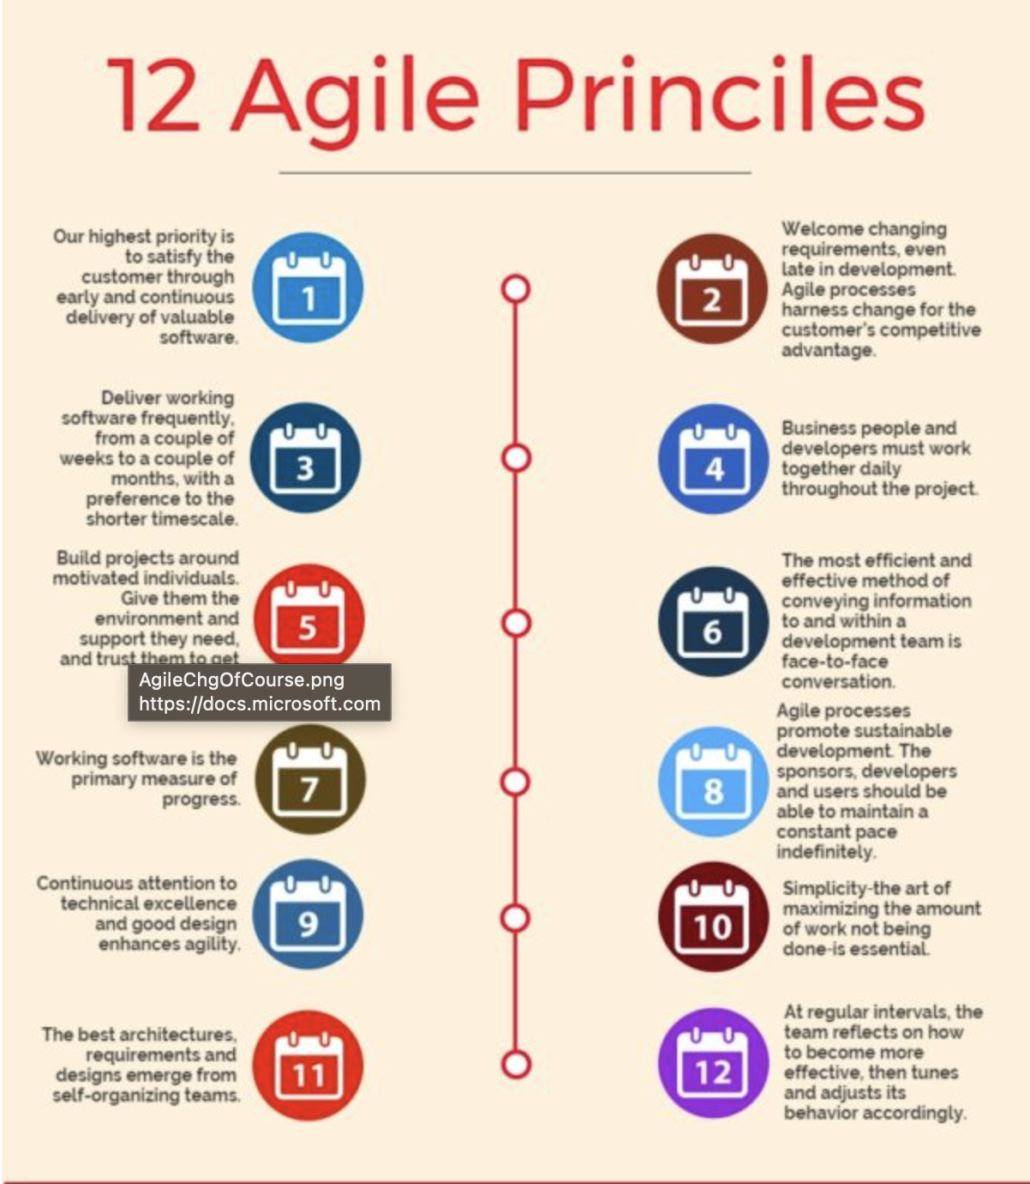
organizational tools and Scrum-agile principles
By adding the custom profile functionality, we best served the customer/user. They can now manage the user experience in a better way that better suits their personality. Allowing them to have a custom session on the travel platform.
By being able to change the SNHU Travel Agency to a wellness and detox platform on a moments notice, we implemented one of the key features of the agile principles. Which was to make changes at anytime.
The collaboration of the Product Owner rewritten user stories for the backlog, our tester emailing the Product owner for deeper insight on the changes, showed the team can work together with a great flow, even if the direction is not necessarily clear.
Practicing TDD (Test Driven Development) to catch bugs early and pass on the proper bug free functionality from tester. to developers.

Slide 10
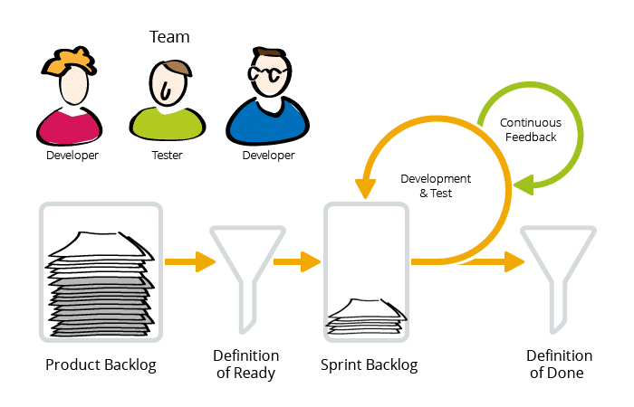
Assess the effectiveness of the Scrum-agile approach for the SNHU Travel project
We were able to take an established platform and not once but twice change it, to satisfy the clients needs.
Created a more flexible platform for the user where they could have a custom user experience and be able to pay in different ways for their trip.
We were able to track bugs and revise our backlog to switch the theme of the travel agency platform on they fly.
Our Product Owner, Scrum Master and the whole scrum team worked like a prepped lean engine to tackle bugs, backlog and properly manage each sprint time efficiently.

Slide 11

References
Lucid Content Team. (n.d.). Lucidchart.com; Lucid Chart. https://www.lucidchart.com/blog/product-owner-roles-and-responsibilities
What is a Scrum Master? (2022). scrum.org. https://www.scrum.org/resources/what-is-a-scrum-master
Jayaraman, V. (2020). The Role of a Tester in Scrum Team. Leanpitch.com. https://leanpitch.com/blogs/role-of-tester-in-scrum-team
Adam. (2020). The Role of the Developer in a Scrum Team. Dotdotdev.com; wordpress.com. https://dotdotdev.com/2021/07/12/the-role-of-the-developer-in-a-scrum-team/
ATTENTION: All inline text citation if hovered will show the proper full citation. If the inline text citation is clicked it will return to this slide.

